Slide 1
Atomic Force Microscopy
Dian Shi

Slide 2
Atomic Force Microscopy (AFM)
Basic principles
FM-AFM
Applications
New developments

Slide 3
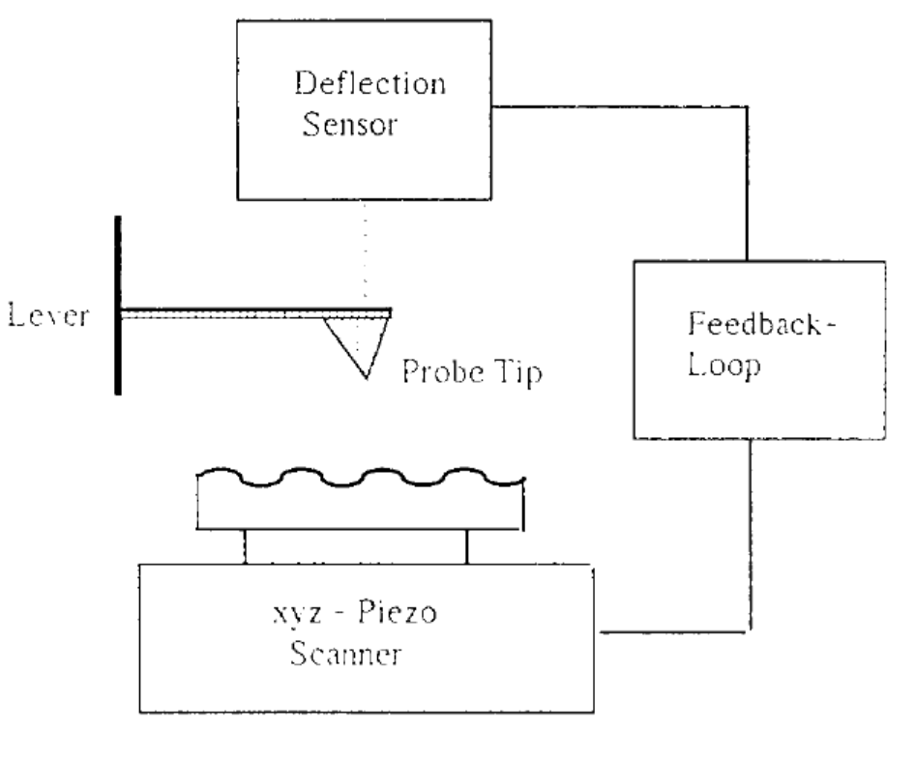
Basic Principles
E. Meyer. “Atomic Force Microscopy.” Progress in Surface Science. 1992

Slide 4

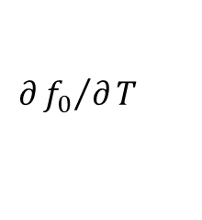
Basic Principles
Tip-sample forces
  Van der Waals, Electrostatic, Magnetic, Capillary, Ionic repulsion, Frictional
Cantilever
  Stiffness k, Eigenfrequency , Quality factor Q, , Tip’s chemical structure
$$f_{0}$$
$$∂{f_{0}}/∂T$$

Slide 5
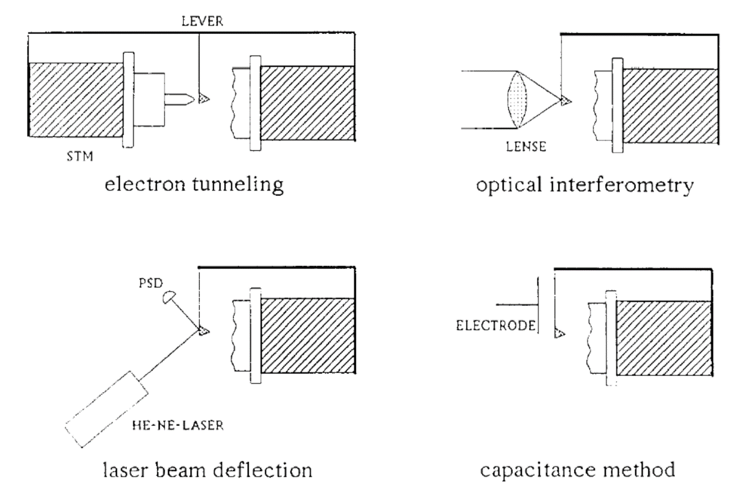
Basic Principles
Deflection sensor
(Meyer, 1992)

Slide 6
Basic Principles
Operation mode
  Static (contact) mode
  Dynamic (noncontact) mode
    Amplitude-modulation (AM)
    Frequency-modulation (FM)

Slide 7
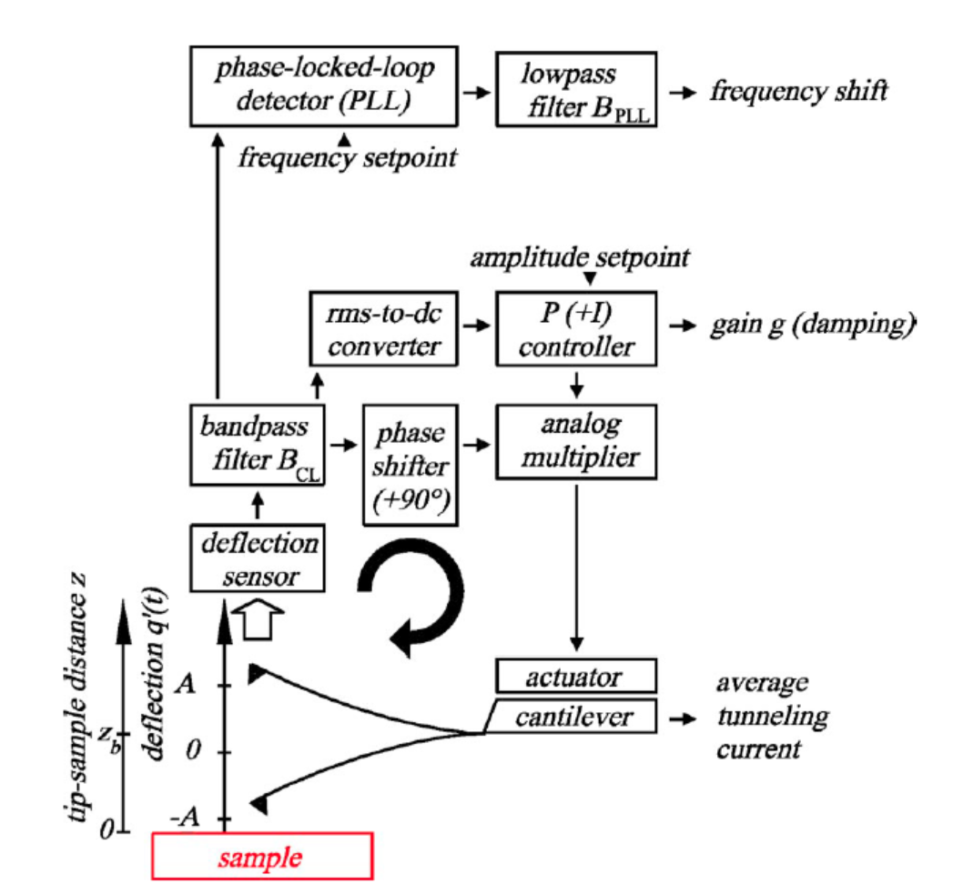
FM-AFM
Experimental setup
(Giessibl, 2003)

Slide 8


FM-AFM
Experimental parameters
  Spring constant of the cantilever k
  Eigenfrequency of the cantilever
  The quality value of the cantilever Q
  The oscillation amplitude A
  He frequency shift of the cantilever
$$f_{0}$$
$$Δf$$

Slide 9
FM-AFM
Physical observables
  Frequency shift
  Average tunneling current
  Damping and dissipative forces

Slide 10
Applications
Imaging
Spectroscopy

Slide 11
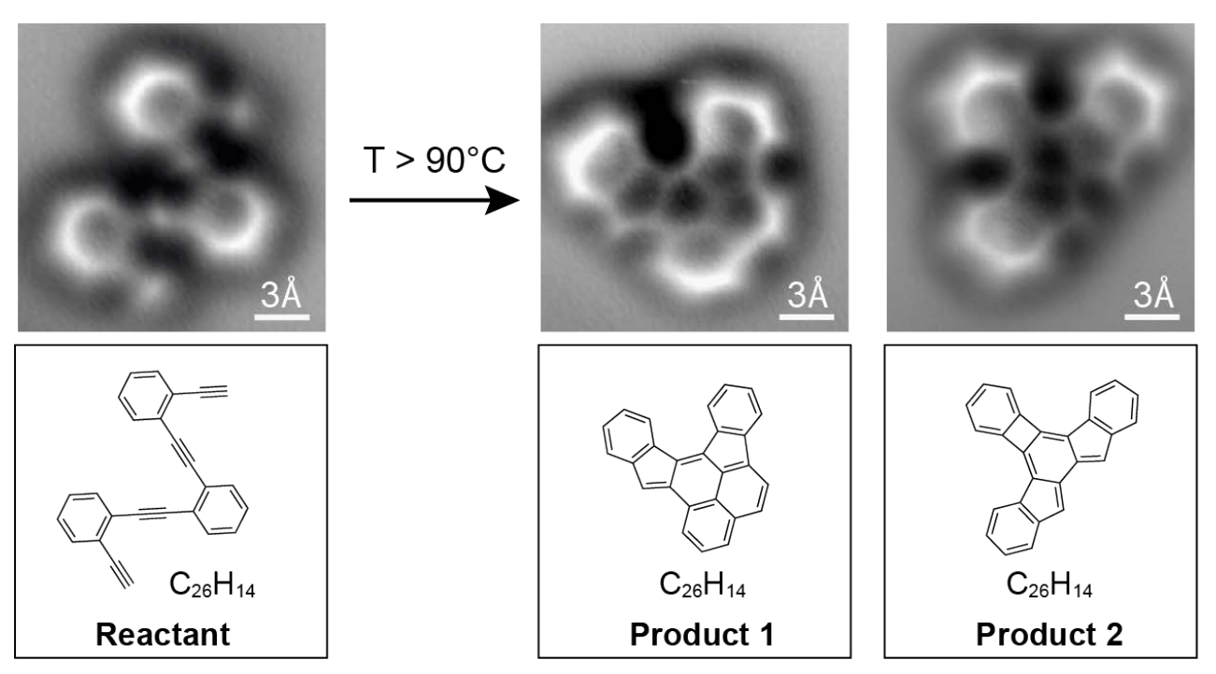
New Developments
Dynamic mode with stiff cantilevers and small amplitudes
  Direct imaging of covalent bond structure (Dimas G. de Oteyza, et al.)

Slide 12
Thank You

